Slide 1

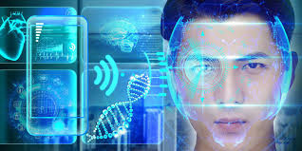

FACIAL RECOGNITION &TRACKING
Presented by: Jiayue Ma

Slide 2
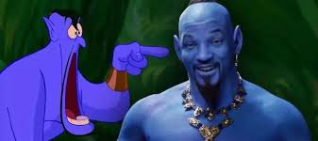
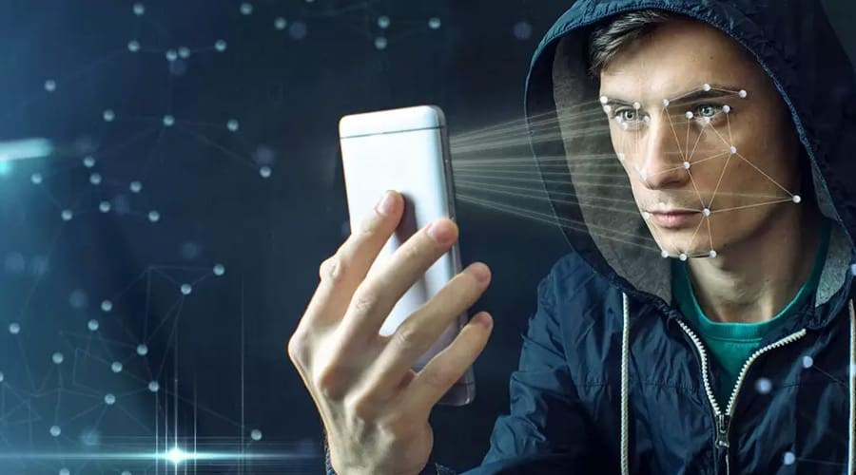
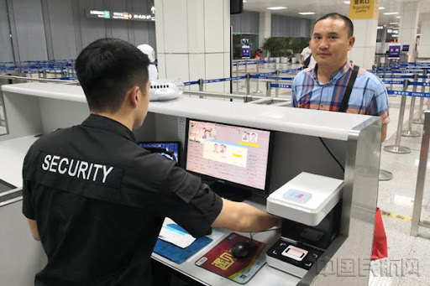

Slide 3






TECH COMPANIES
google
Microsoft
Amazon
Face++
SenseTime
NEC

Slide 4



MAINSTREAM TECH ON FACICAL RECOGNITION
01
02
03
04
05
Methods Based on Traditional Machine Learning：Feature Extraction，Classifier Design
Methods Based on Deep Learning：Convolutional Neural Networks (CNN)，End-to-End Learning
3D Facial Recognition：
3D Modeling，Deep Learning with 3D Data
Infrared and Thermal Imaging Technology：Infrared Imaging，Combining Visible Light with Infrared Data
Multimodal Facial Recognition：Integration of Voice, Video, and Biometrics

Slide 5





PROSPECTS AND CHALLENGES
PROSPECTS
CHALLENGES
Widespread Integration
Advancements in Technology
Increased Accuracy in
Diverse Conditions
Expanding Applications
Privacy Concerns
Bias and Fairness
Regulatory Compliance
Security Vulnerabilities

Slide 6


Slide 7

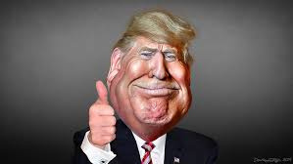
Finding Donald
By generating a facial feature model from approximately 2000 of Trump’s pictures, then using the facial features to mark his position in the video.

Slide 8

PyTorch is an open-source machine learning library widely used for applications such as computer vision and natural language processing. It provides a flexible platform for deep learning research.
Pytorch
OpenCV is an open-source library focused on real-time computer vision. The code uses OpenCV to capture and process video frames and detect faces, among other tasks.
OpenCV
PIL (now known as Pillow as an active fork) is a powerful image processing library used for opening, manipulating, and saving many kinds of image formats.
PIL
Torchvision library includes tools for image processing and pre-trained models like MobileNet, designed to be used with the PyTorch deep learning framework.
Torchvision
MobileNet is an efficient convolutional neural network suited for mobile and embedded vision applications. In your code, a pretrained MobileNet v2 model is used to extract features, developed by researchers at Google.
MobileNet

Slide 9

PROCEDURES
Load Pre-trained Model:
Image Preprocessing
Feature Extraction:
Video
Annotation
Similarity
Comparison

Slide 10

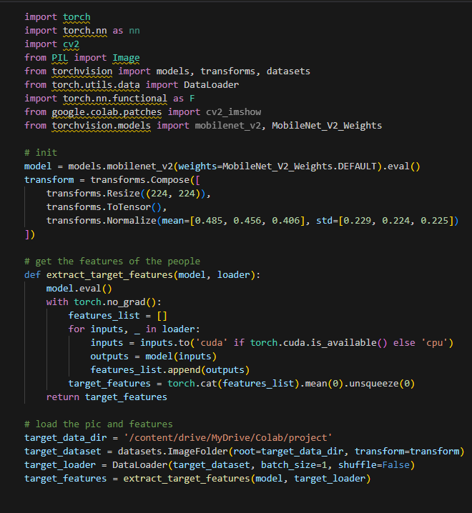
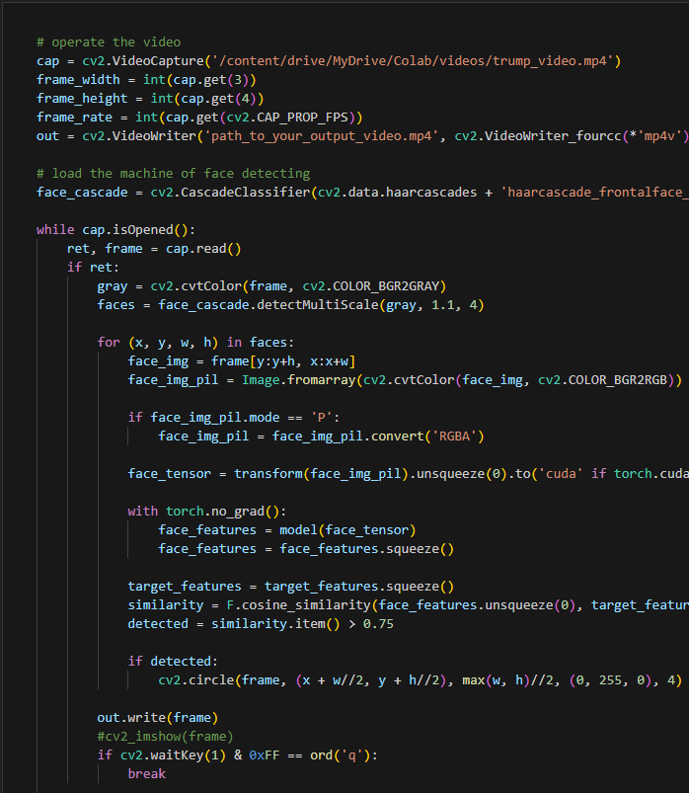
CODES

Slide 11
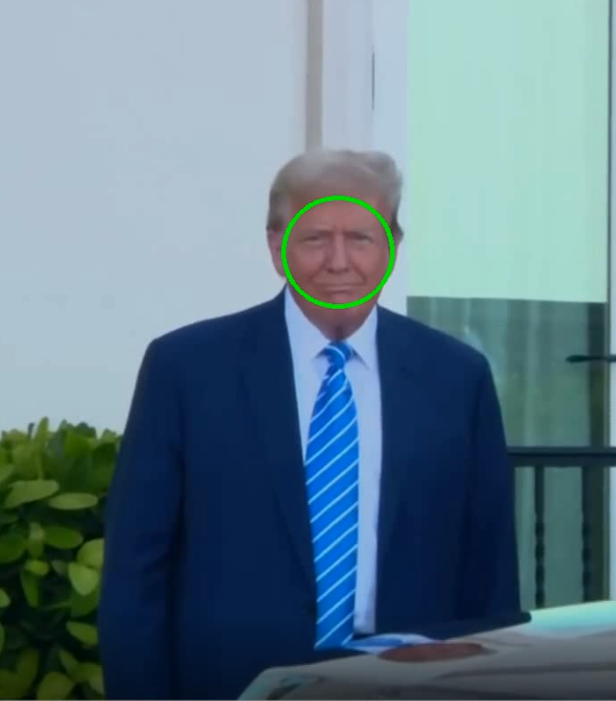
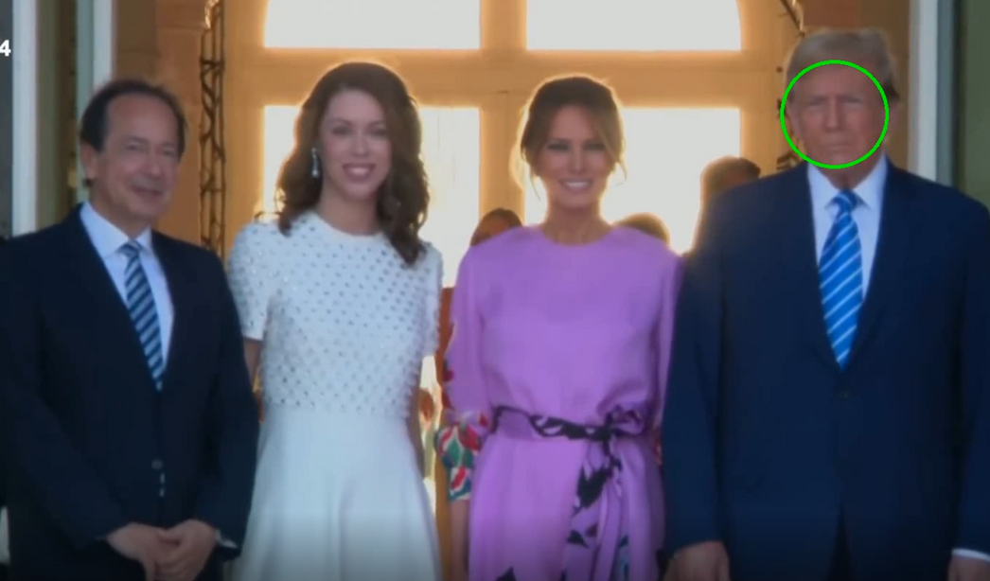

SIMILIRATITY 65%

Slide 12

THANK YOU

